Slide 1
Overview of topic
OGC API Security Considerations
Andreas Matheus (Secure Dimensions)
30 September 2020

Slide 2
OGC API – Common and Security
Must security not be part of OGC API Common?
If yes, what are the implications to standardization?
E.g. the HTTP POST dilemma
What about the HTTP POST dilemma?
HTTP POST /collections/<abc> <payload=GET query> => alternative to HTTP GET /collections/<abc>?<query> if URL gets too long!
HTTP POST /collections/<abc> <payload=feature content> => create one/multiple resources
Let's make sure that you can use SECURITY with OGC API

Slide 3
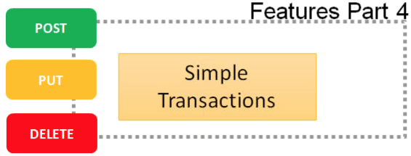
Protecting OGC API – Features
An API that supports CRUD should be protected
OGC API - Features with Simple Transactions supports CRUD
HTTP POST …/collections/<feature_type> PAYLOAD Creates a feature
HTTP PUT …/collections/<feature_type>/<feature_instance> PAYLOAD Updates a feature entirely
HTTP PATCH …/collections/<feature_type>/<feature_instance> PAYLOAD Updates a feature partially
HTTP DELETE …/collections/<feature_type>/<feature_instance> Deletes the instance
Protected means there is a need for Access Control
OGC API – Features implementations are described using OpenAPI
OpenAPI security schemes include Bearer Token

Slide 4
Protecting OGC API – Features / Sprint Goals
API endpoint HTTP methods POST, PUT and PATCH require the client application to submit Bearer Tokens via HTTP Authorization <bearer token>
When using POST, no query parameters are to be used
Bearer Access Token can be obtained from OpenID Connect compliant Authorization Server (Authentication as a Service)
https://www.authenix.eu/api
Proposed Goals
One participant implements / configures the API endpoint for transactions to require Bearer Token; validates Bearer Token with AUTHENIX
Another participant includes OpenID Connect into client applications (e.g. HelloJS for Web-Browser / JavaScript based applications) to obtain access token from AUTHENIX

Slide 5
Using AUTHENIX (Authentication as a Service)
Identity Management Federation
Authentication as a Service
https://www.authenix.eu/
OAuth2 /
OpenID Connect
UserInfo per
OpenID Connect
<login>
Token Introspection
RFC 7662
OGC API +
Security
Data
Store
Application
OGC API + RFC 6750
components:
securitySchemes:
bearerAuth:
type: http
scheme: bearer
paths:
/collections/<collectionId>/<items>:
post:
security:
- bearerAuth: []
put:
security:
- bearerAuth: []
delete:
security:
- bearerAuth: []
Internet
Internal Network

Slide 6
AUTHENIX – For Developers
https://www.authenix.eu/api
OpenAPI description of API for developers
https://www.authenix.eu/.well-known/openid-configuration
OpenID Connect discovery URL
Application (Service) Registration
RFC 7591: https://www.authenix.eu/oauth/register
Manual: https://www.authenix.eu/registerapps
Application Registration Legal
You must provide a URL to the Terms Of Use
If your application / service is going to fetch personal information, you must provide a URL to the Privacy Statement
You must specify the Creative Commons license for your application (how others can use the application once registered)

Slide 7
Andreas Matheus
Secure Dimensions
am@secure-dimensions.de

